Slide 1

RATS 재학생 세미나
Arduino LAB

Slide 2
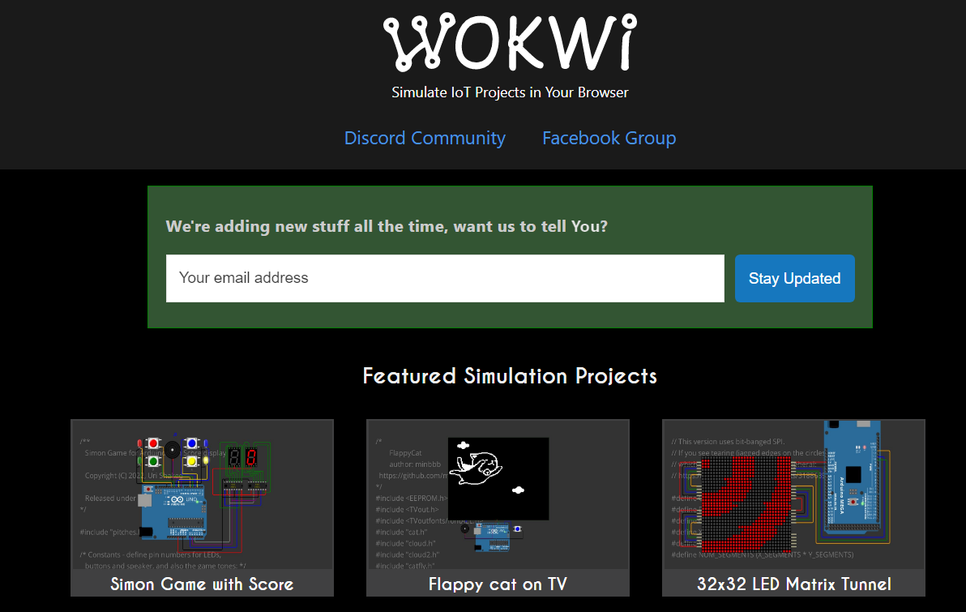
온라인 시뮬레이터 환경
https://wokwi.com/

Slide 3
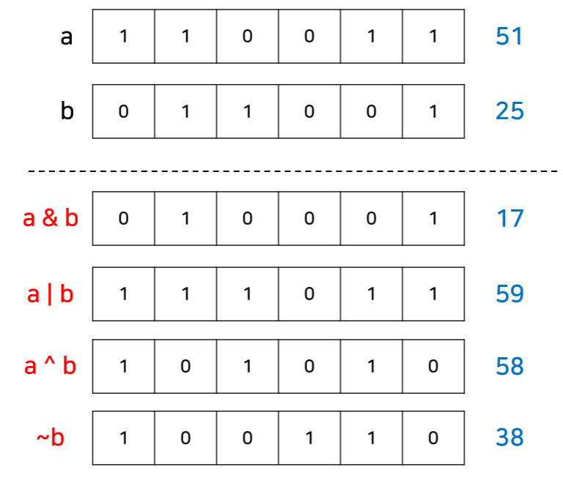
LAB 01_비트 연산
https://wokwi.com/projects/340480319182340691

Slide 4
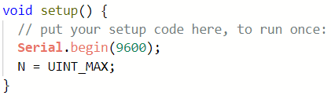
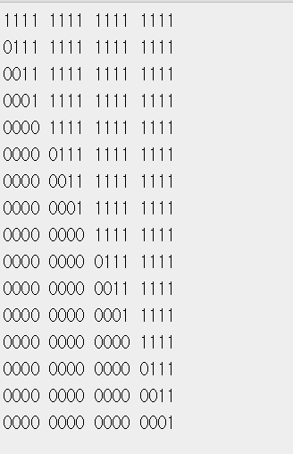
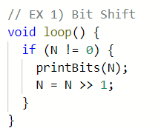
LAB 01_비트 연산
1. 비트 시프트

Slide 5
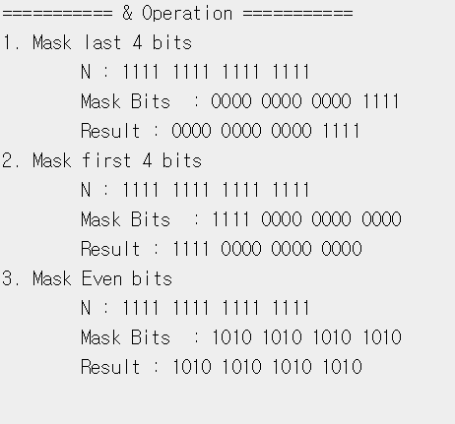
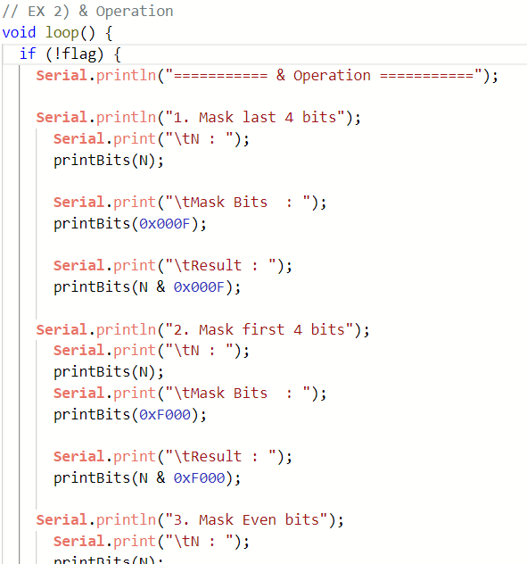
LAB 01_비트 연산
2. & 연산

Slide 6
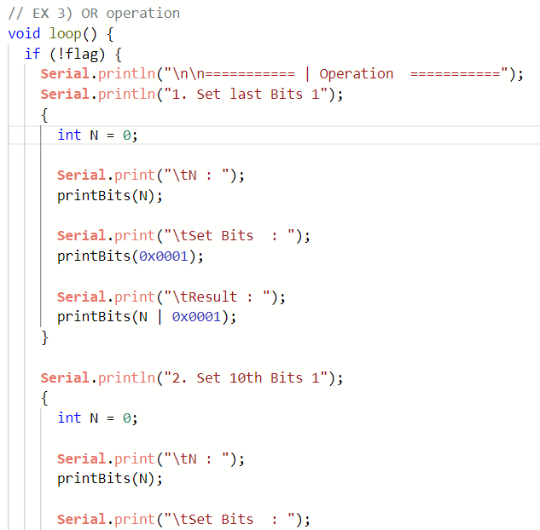
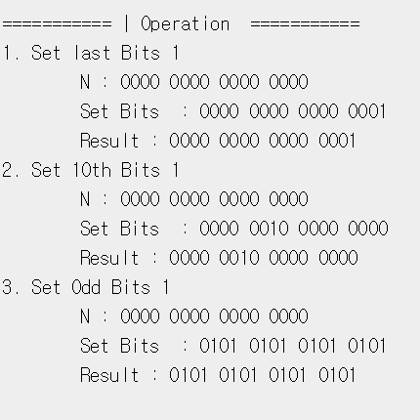
LAB 01_비트 연산
3. or 연산

Slide 7
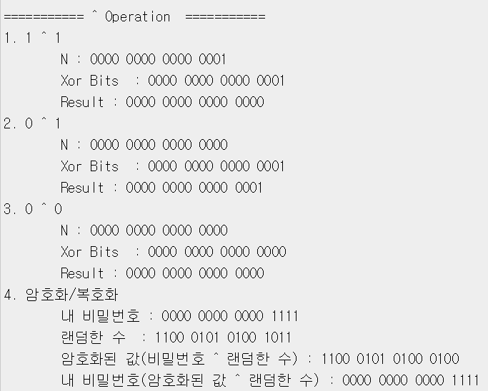
LAB 01_비트 연산
4. xor 연산

Slide 8
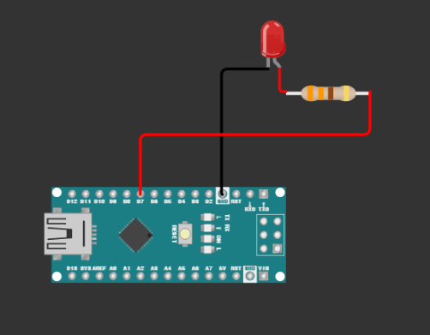
LAB 02_GPIO
1. LED Blinking (DigitalWrite)
내부 LED
https://wokwi.com/projects/340484017719607892
외부 LED
https://wokwi.com/projects/340484866040660562

Slide 9

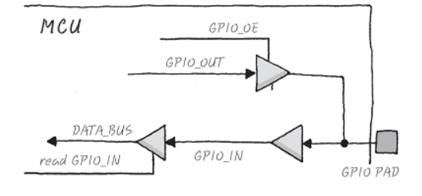
LAB 02_GPIO

Slide 10
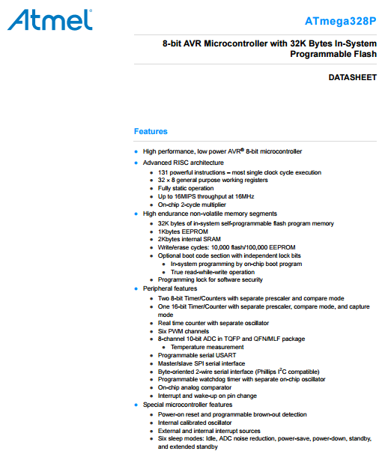
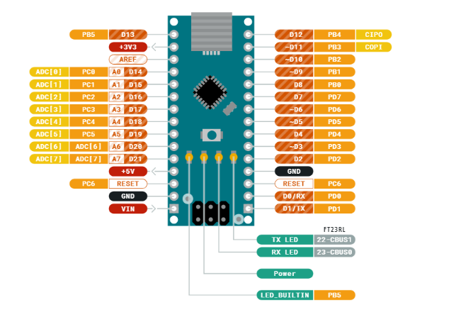
LAB 02_GPIO
2. LED Blinking (Register)
내부 LED
https://wokwi.com/projects/340485215288820307
외부 LED
https://wokwi.com/projects/340486244371792466

Slide 11
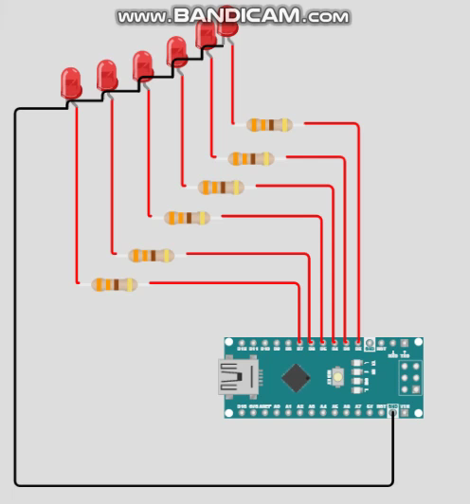
LAB 02_GPIO Quiz
2. LED Blinking (Register)
문제
https://wokwi.com/projects/340486863634563667

Slide 12
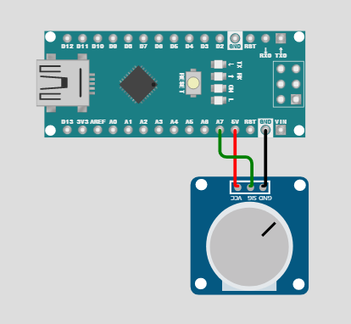
LAB 03_ADC
1. ADC (analogRead)
https://wokwi.com/projects/340487179438391891

Slide 13
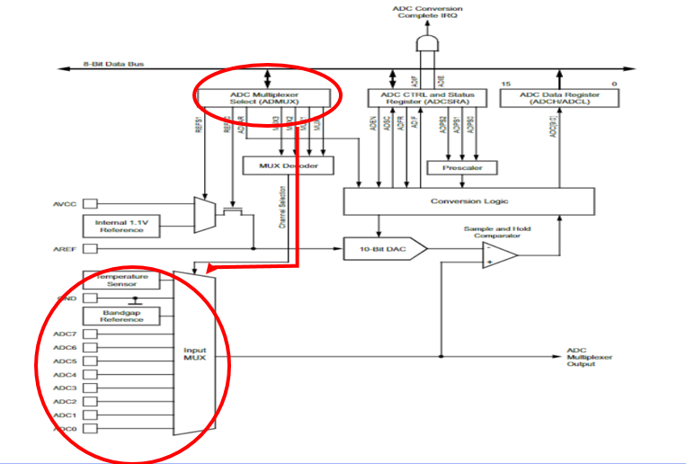
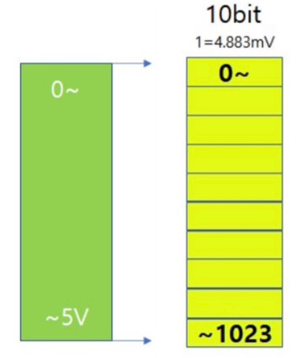
LAB 03_ADC

Slide 14
LAB 03_ADC_구현
1. ADC (Register)
https://wokwi.com/projects/340488518594724434

Slide 15
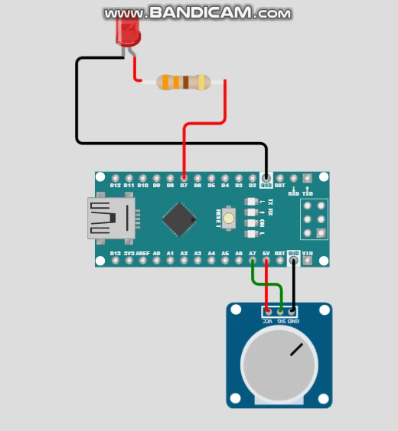
LAB 03_ADC_응용
2. ADC Quiz (Register)
https://wokwi.com/projects/341055057285874258

Slide 16
LAB 04_Timer
1. Polling
https://wokwi.com/projects/341220690498683475
2. Timer
https://wokwi.com/projects/340494996894384724

Slide 17
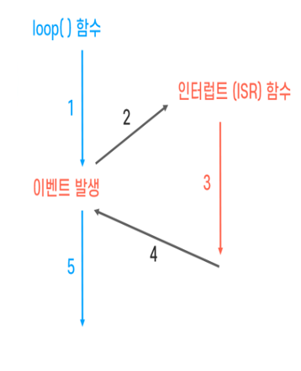
LAB 04_Timer
Polling
Interrupt
loop()
if (i == 250)
i가 몇이든 언제나 확인

Slide 18
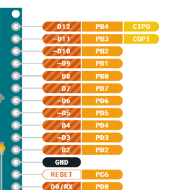
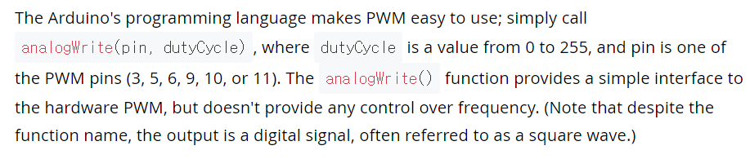
LAB 05_PWM
1. PWM(analogWrite)
https://wokwi.com/projects/341055559577895507

Slide 19
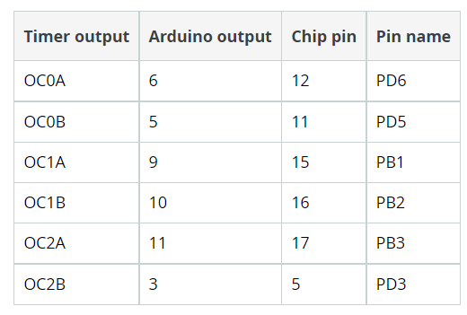
LAB 05_PWM
2. PWM(Register)
https://wokwi.com/projects/340498785962558036

Slide 20
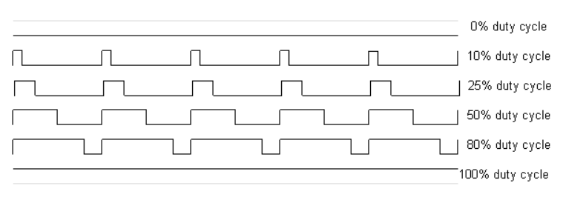
LAB 05_PWM
3. PWM(With Delay)
https://wokwi.com/projects/341223501352403540

